Slide 1
POWER BI
A business intelligence tool
1

Slide 2
What is Power Bi?
Power BI is a Data Visualization and Business Intelligence tool that converts data from different data sources to interactive dashboards and BI reports

Slide 3
Power BI is a is a collection of components:
Power Query - For Cleaning the data
Power Pivot – creating relationship between multiple data sources
Power View – to create different type of charts
Power BI Service – It is a SAAS based online service to share

Slide 4
Why Power BI?
Speed
User Friendly
Eye-catching and Interactive Dashboards
Maximum Features (functions , visuals)
Cost – cheapest tool
Data connectivity – can connect to ~ 100 data source

Slide 5
How Power BI works ?
Power BI Desktop – used to create reports
Power BI Service – used to publish the report

Slide 6
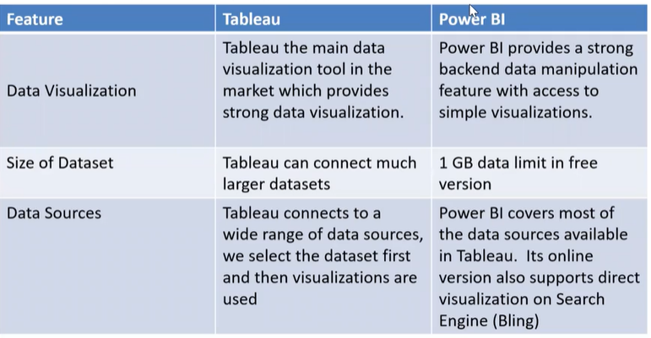
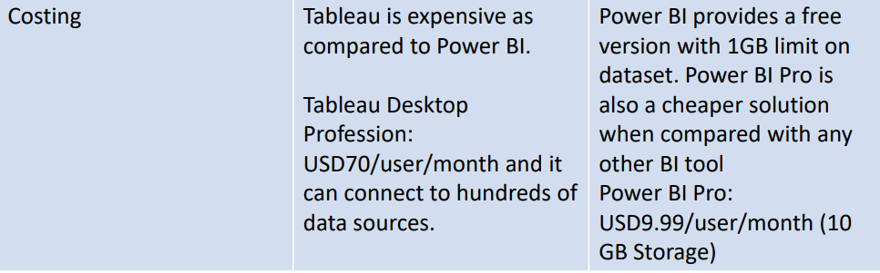
Comparison

Slide 7
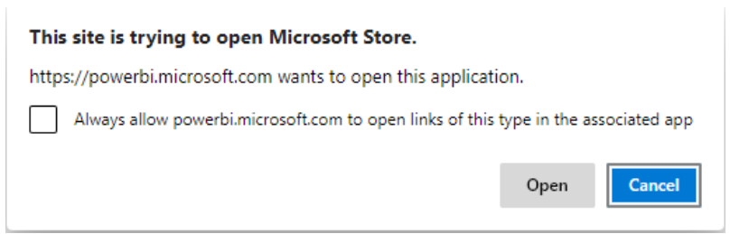
Installing Power BI
To download the latest version, use the following link:
https://powerbi.microsoft.com/en-us/downloads/ Click on download
– You will be prompted to open the MS store click Open

Slide 8
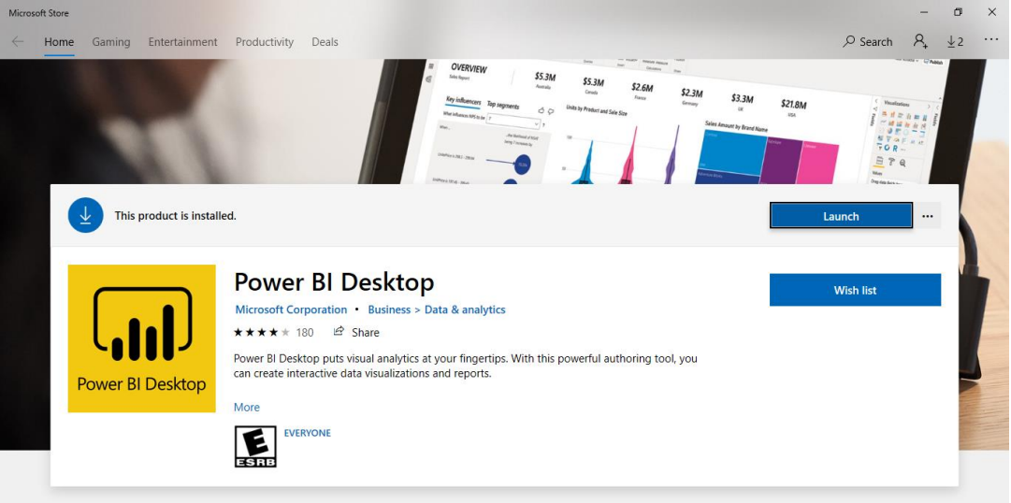
Once Downloaded you will be getting the launch button
Power Bi upgrades every month

Slide 9
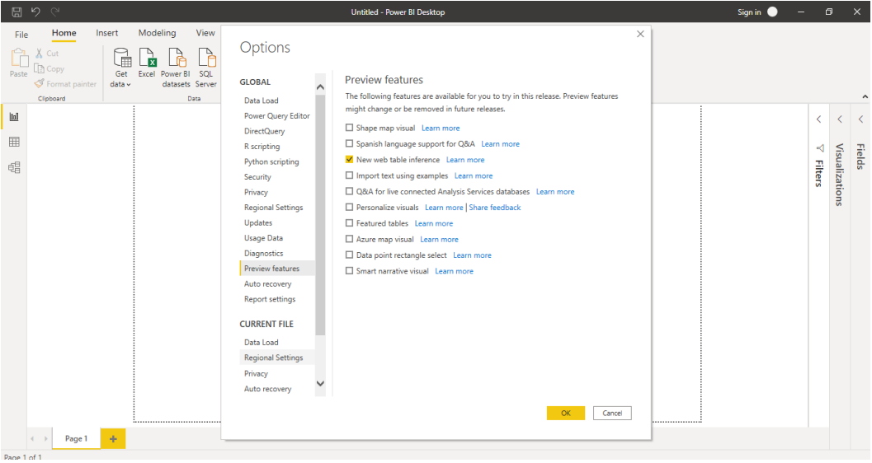
Use Preview Features (File -> Options) to update Power BI

Slide 10
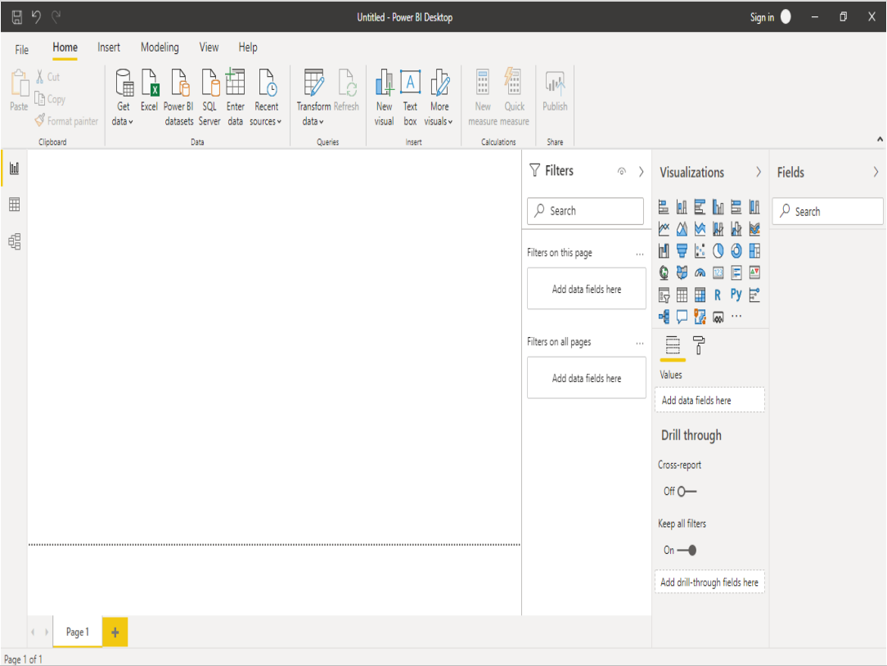

Slide 11
Three Steps in Power BI
• Get the Data in Power BI− It involves locating the data and using an appropriate type of connection to read the data.
• Choose the visualization − This involves selecting the chart type to be created.
• Select the fields to be worked on − This involves moving the fields to the desired area.

Slide 12
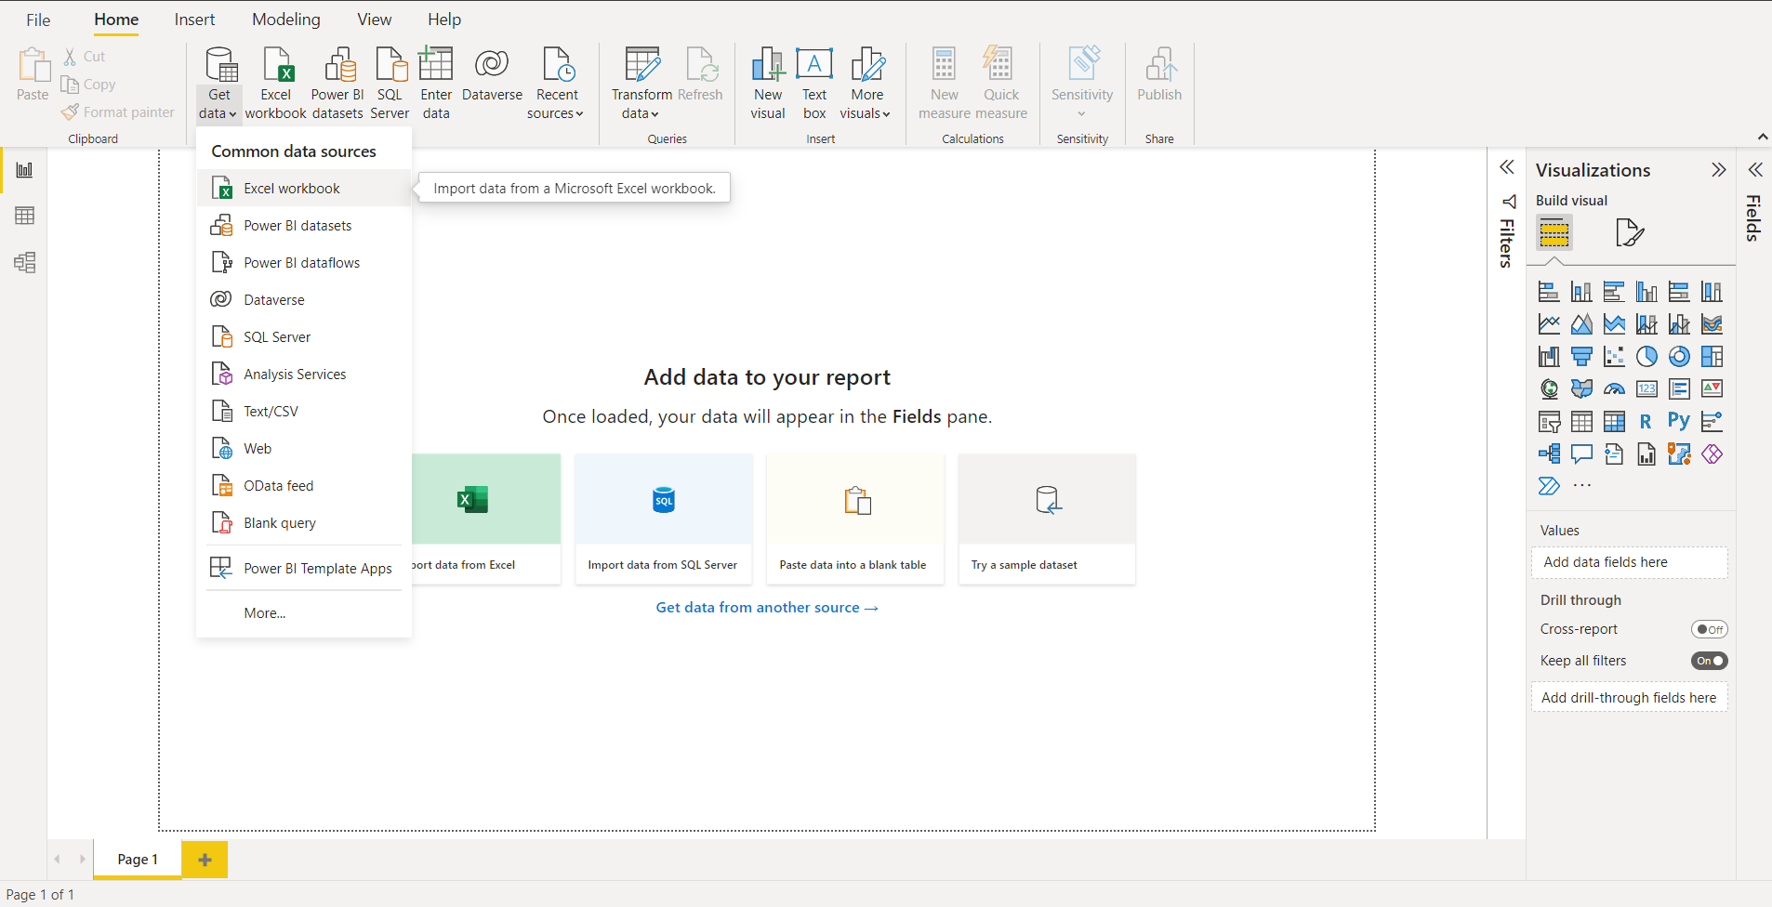
Basic Charts in Power BI :
Connect to a data source − It involves locating the data and using an appropriate type of connection to read the data.
Power BI supports large range of data sources. You can click Get data and it shows you all the available data connections.

Slide 13
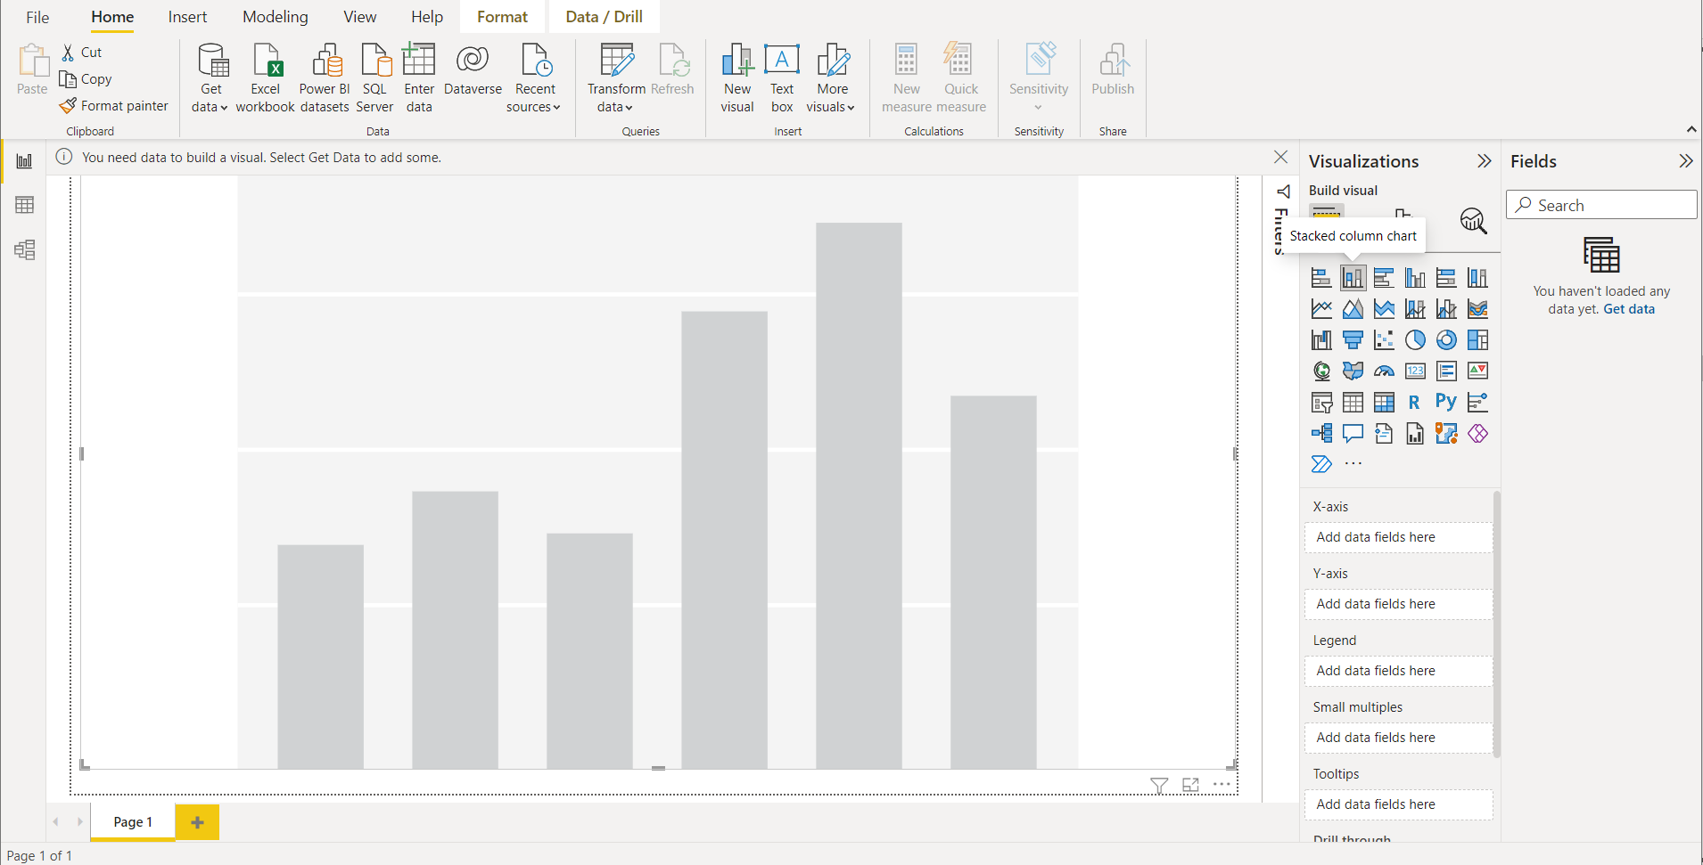
2. Choose the visualization − This involves selecting the chart type to be created

Slide 14
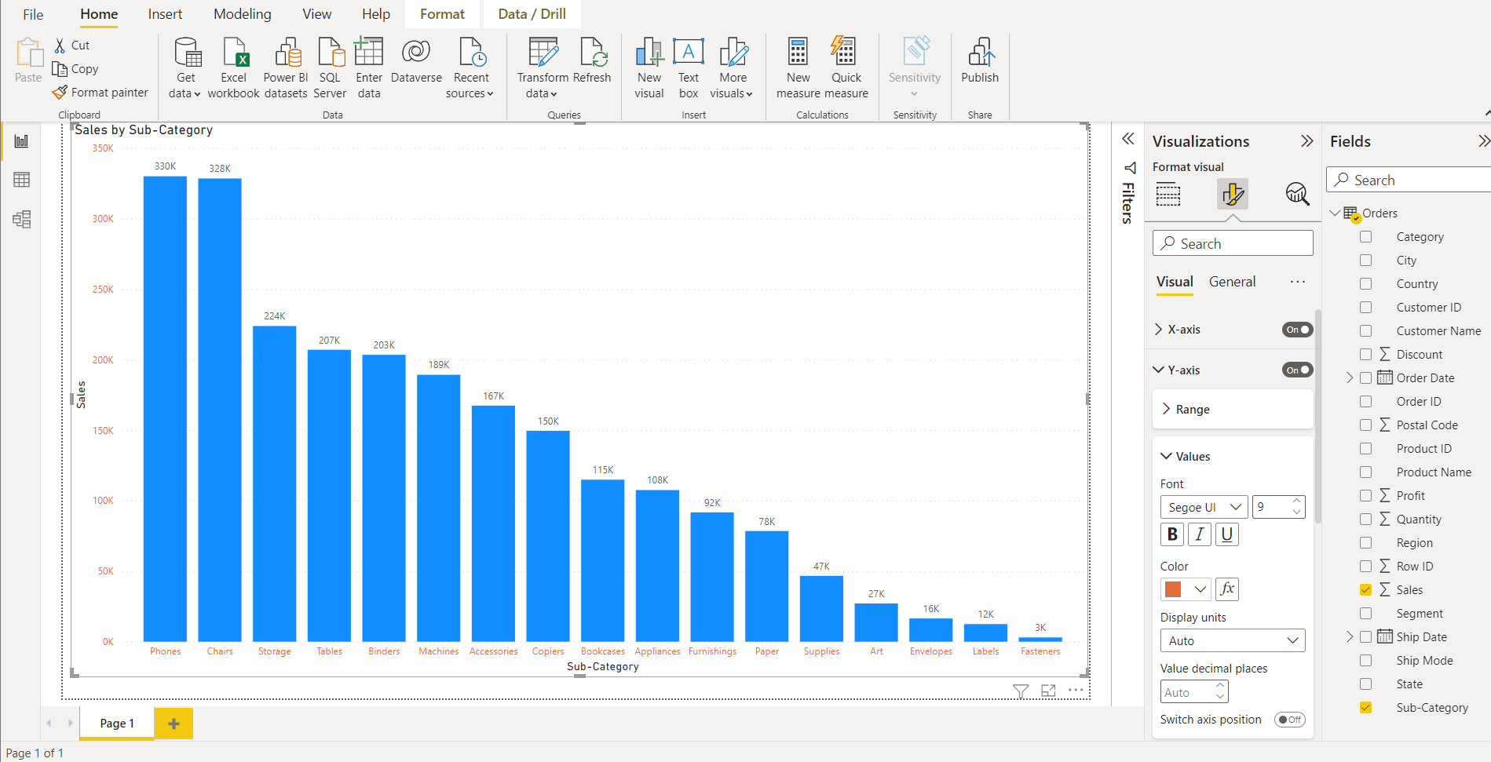
3.Select the fields to be worked on − This involves moving the fields to the desired area

Slide 15
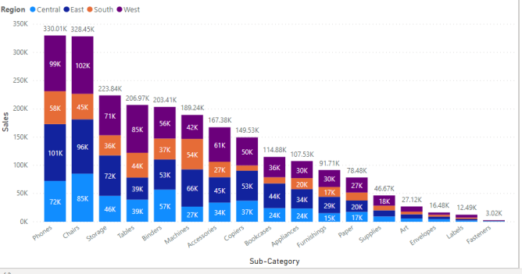
– Stacked Bar Chart

Slide 16
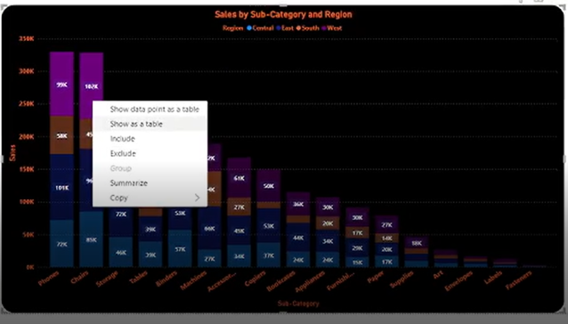
– Include / Exclude
In order to focus on a specific set of points you can now select one or more points and right click to include or exclude points in your visual. Include will filter out all points except for those you’ve chosen to include. Exclude will filter out the points you’ve chosen to exclude

Slide 17
– Export Data from Chart This feature allows you to export the detailed data directly from the chart

Slide 18
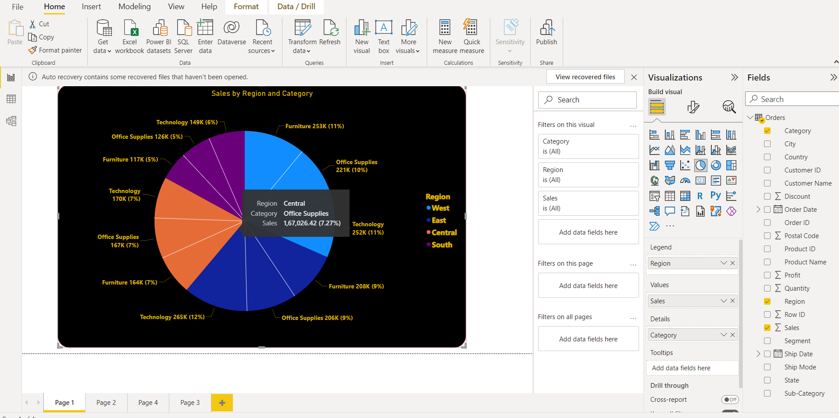
Pie Chart

Slide 19
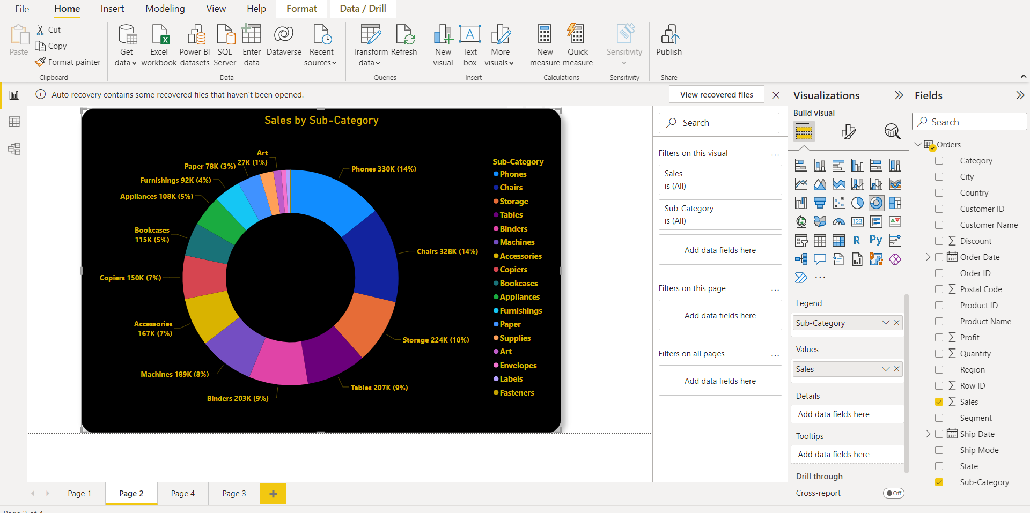
Donut Chart

Slide 20
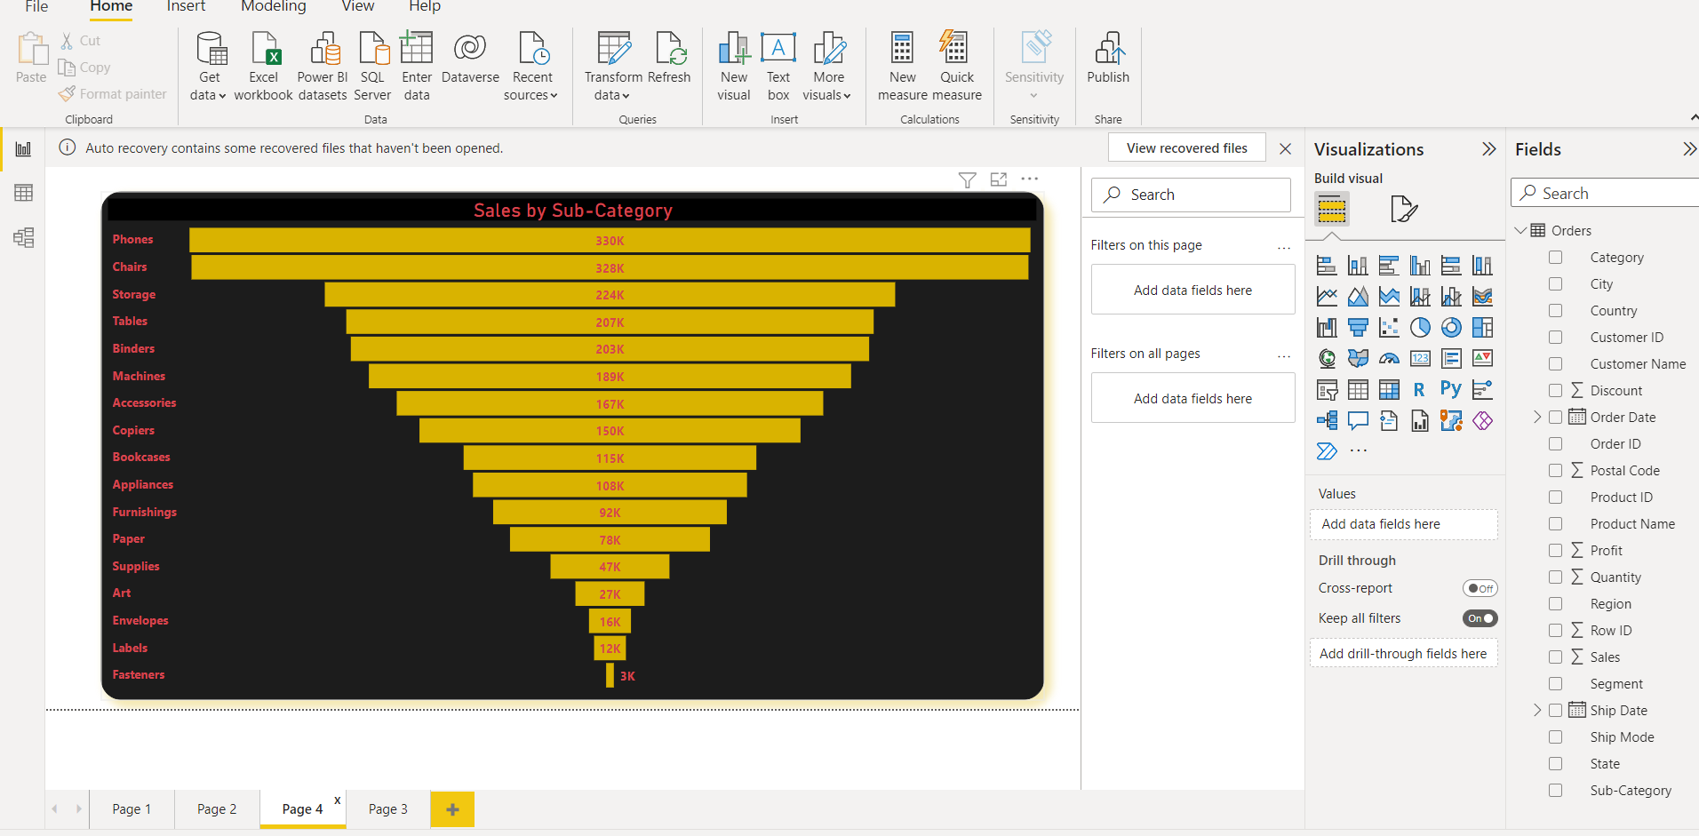
Funnel Chart

Slide 21
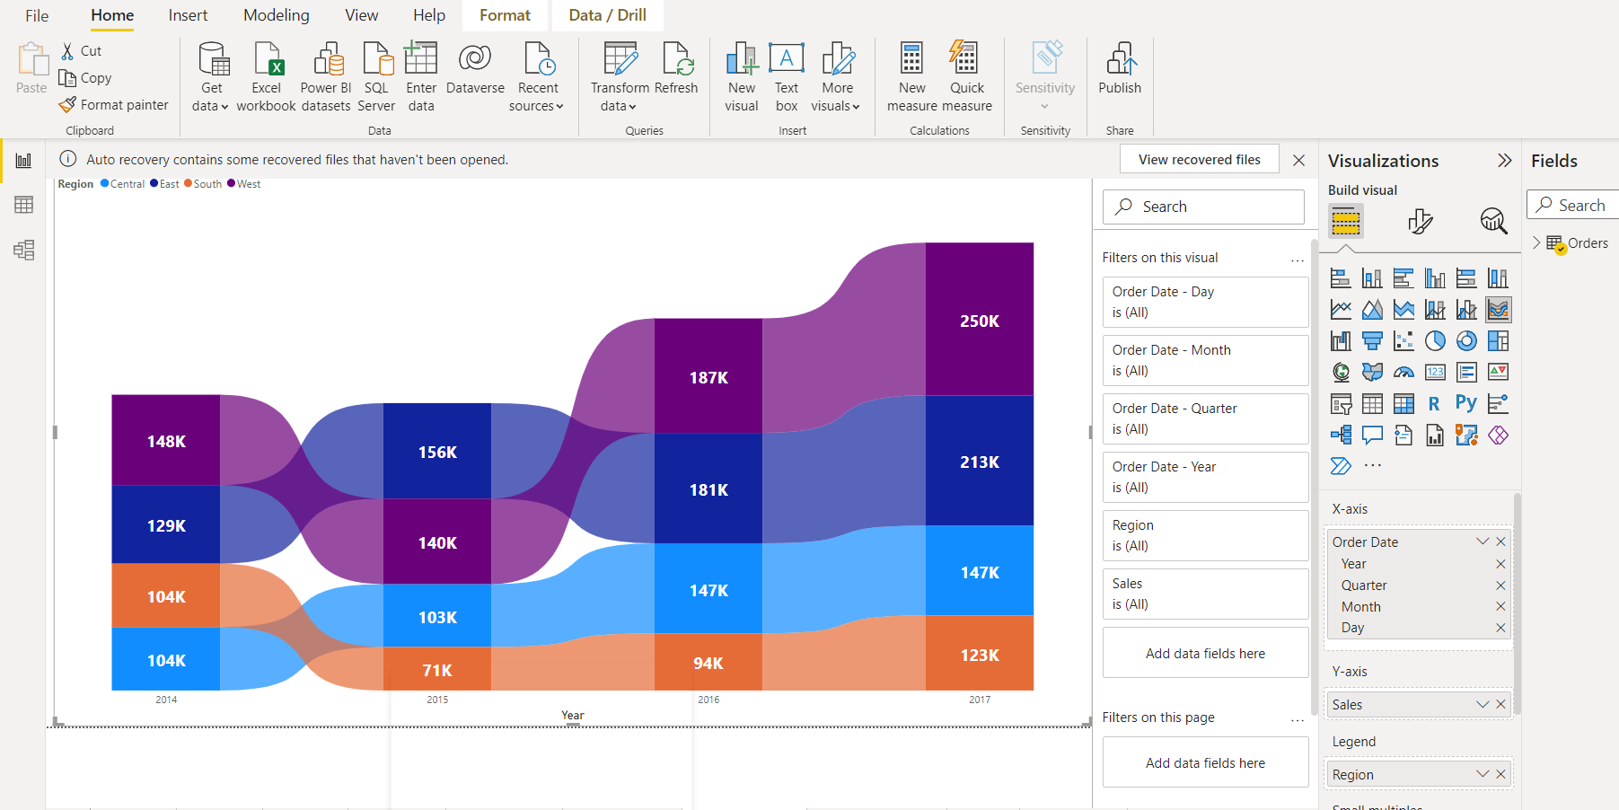
Ribbon Chart

Slide 22
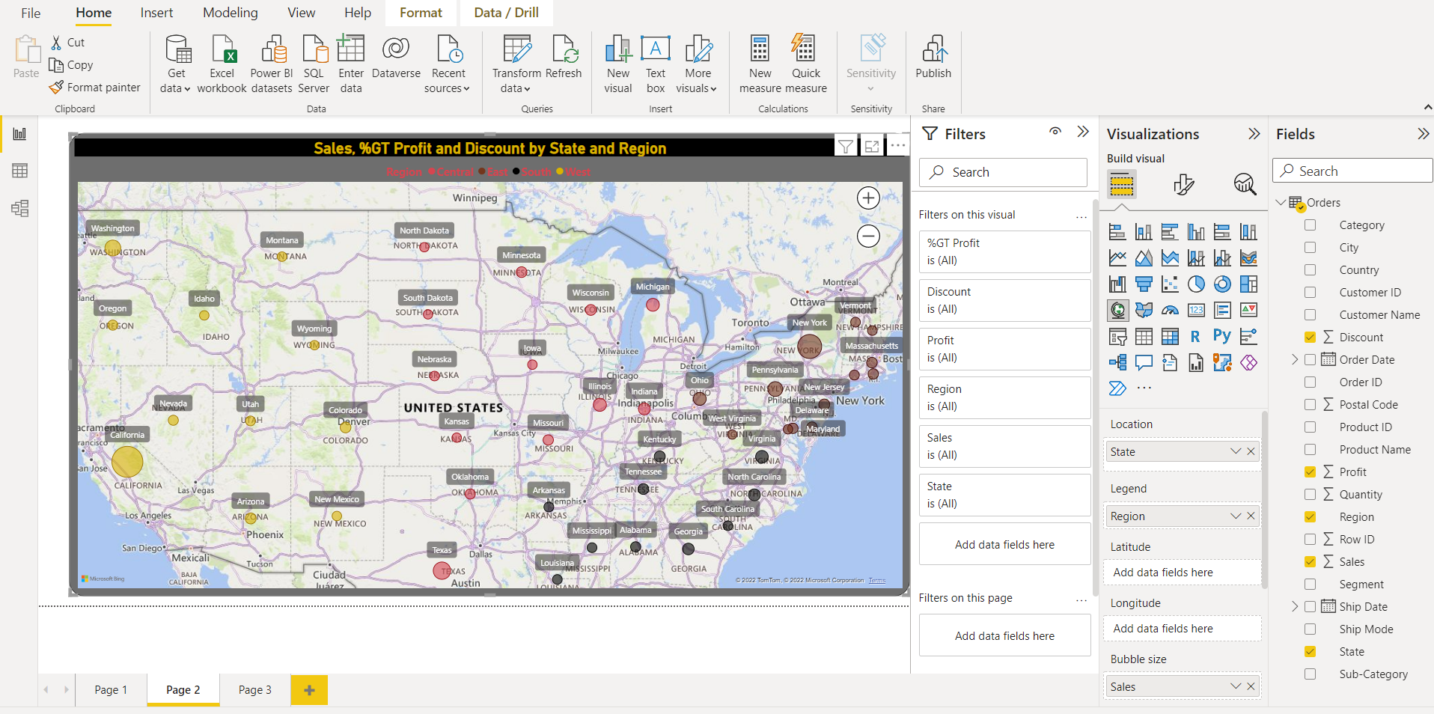
Map in Power BI
Power BI provides two types of map visualization - bubble maps and shape maps. To create a Map you need some geographical Data type such as Country , State, City , Postal code , Latitude, longitude etc..

Slide 23
Map in Power BI - Filed Map
A filled map uses shading [from light (less-frequent/lower) to dark (more-frequent/more)] to display how a value differs in proportion across a geography or region

Slide 24
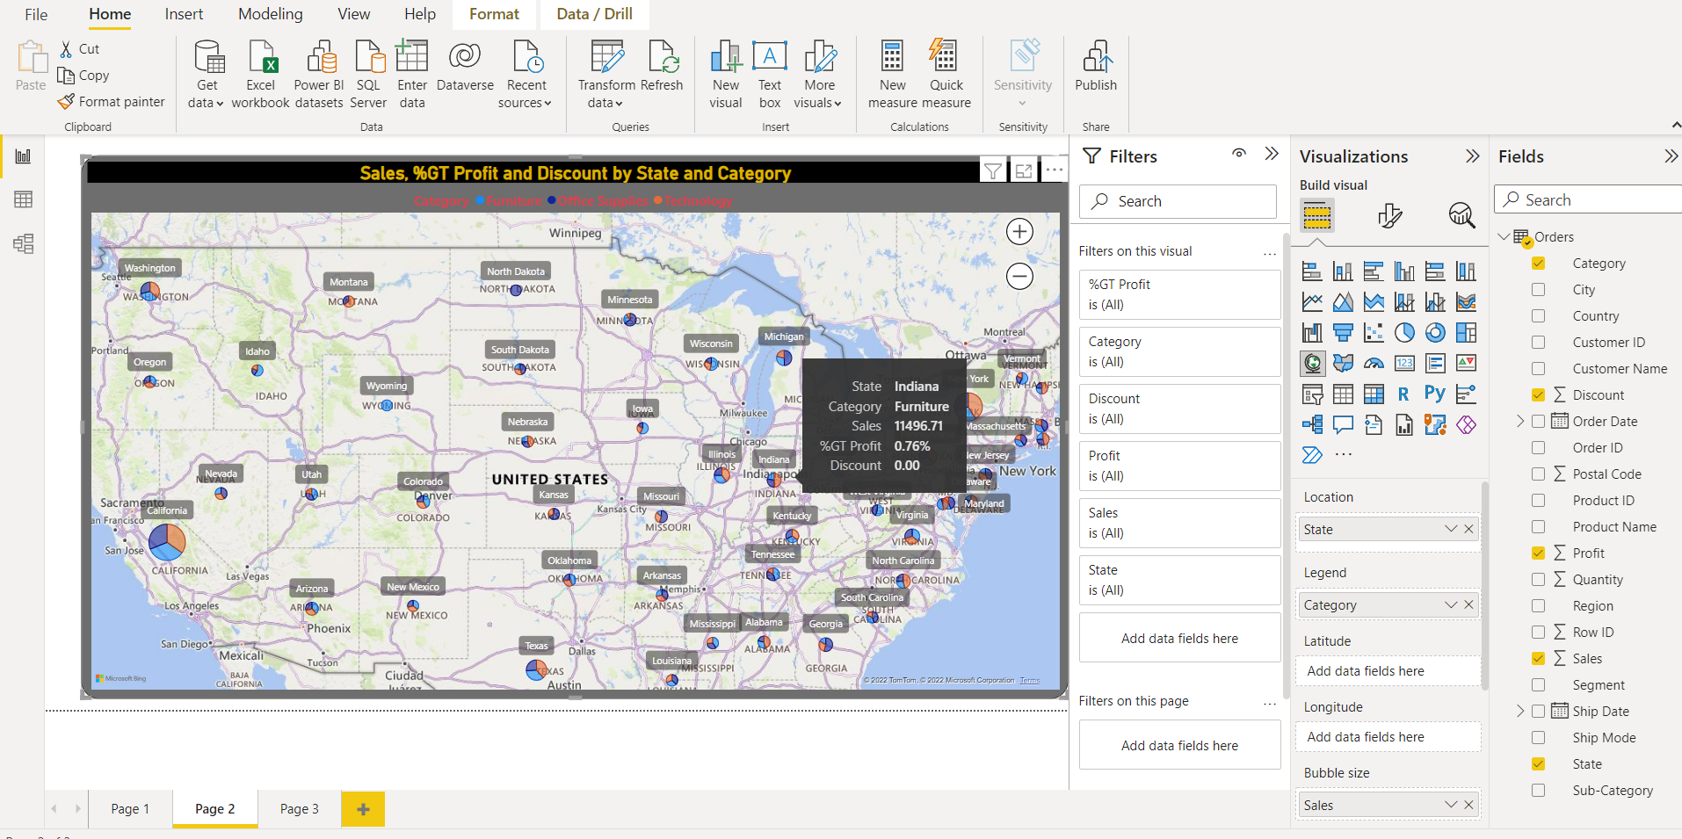
Map in Power BI - Map with Pie
It a blend of Map & Pie where no. of Pie chart are plotted on the map

Slide 25
Map in Power BI - Formatting
Map Formatting options are available under Map controls to enhance the Map
• Data Colors – change the color of data bubble
• Category – get the name of states
• Bubbles – change size of bubble
• Map Controls – Zoom in & Zoom Out Buttons
• Title – Map Title
• Tool Tip – format tool tip box
• Map Styles – change the map background

Slide 26
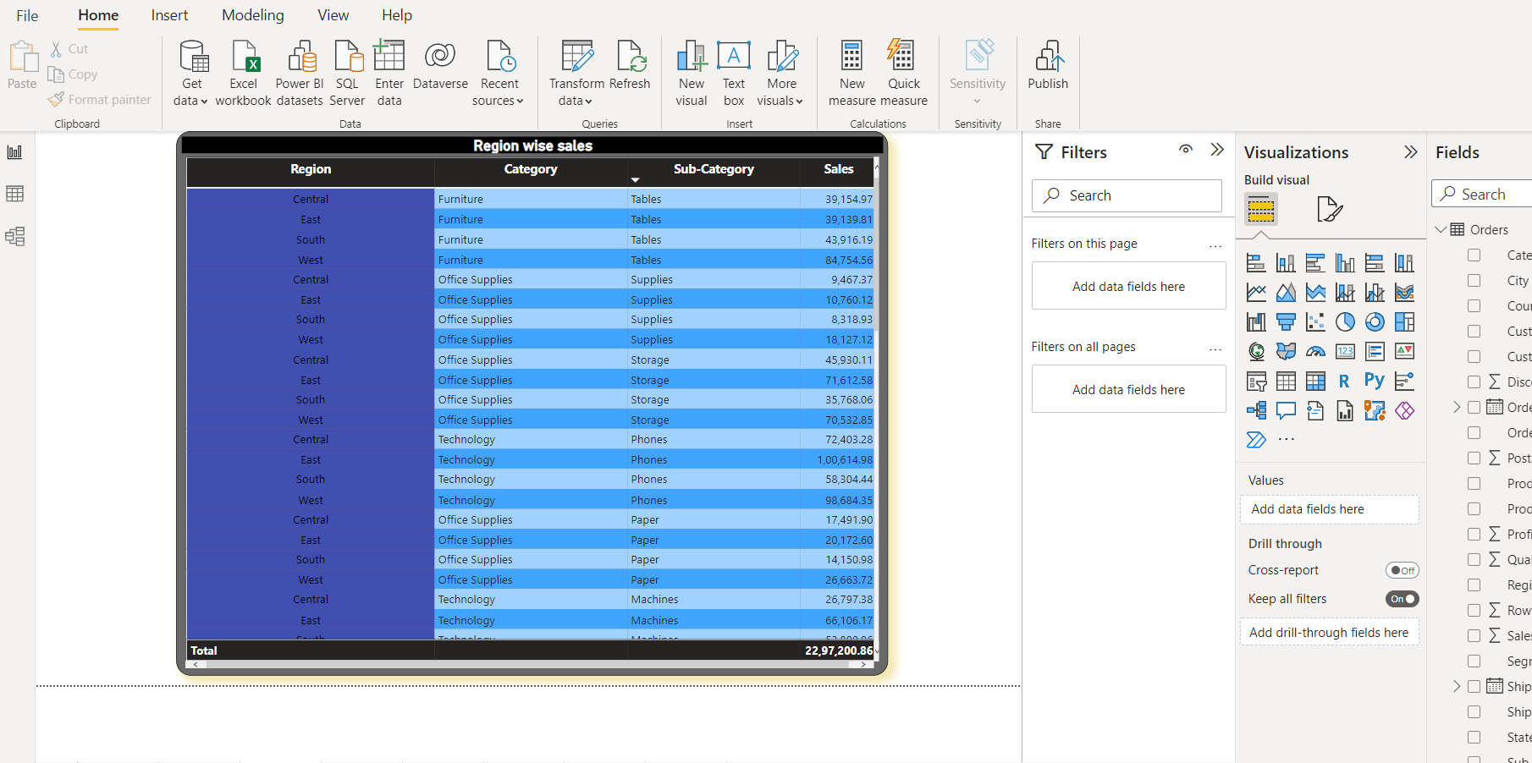
Tabular Data in Power BI - Tables
Use the Table under Visualizations and add the required fields in the Value box

Slide 27
Formatting Tables
• Changing the Font size : Values –> Text Size
• Changing the Column Header Size : Column Headers –> Text Size
• Adding Grid : Grid - > Vertical Grid / Horizontal Grid
• Table Auto Format : Style -> Bold Header
• Field Formatting
• Back Ground Color
• Add title

Slide 28
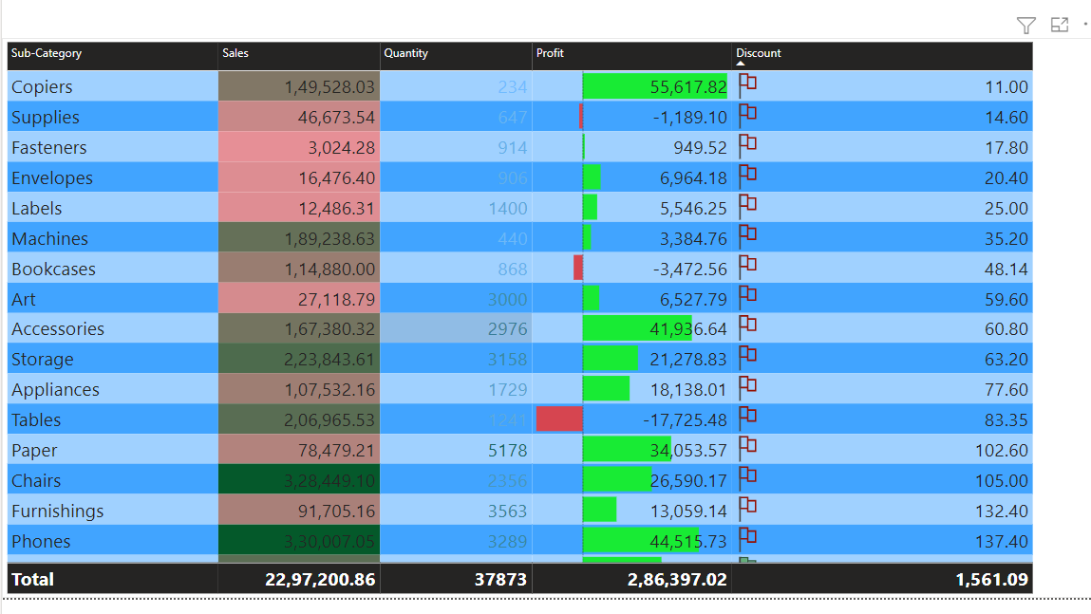
-Conditional Formatting
Formatting the data based on the condition is known as Conditional Formatting

Slide 29
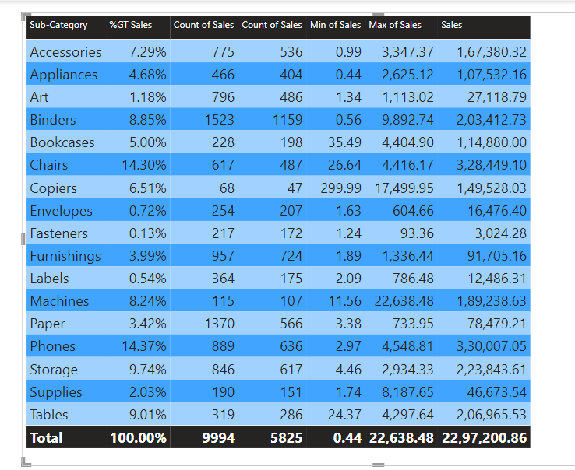
Table Aggregation

Slide 30
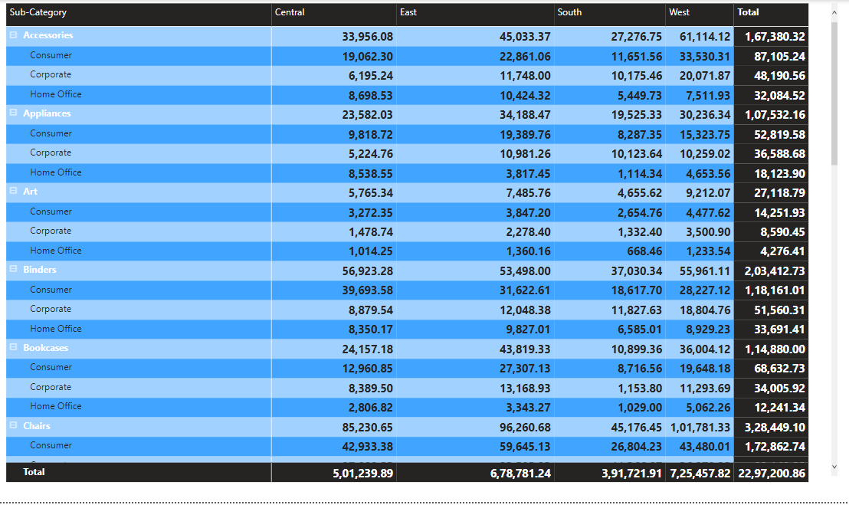
Tabular Data in Power BI-Matrix
The matrix is similar to a table. In table duplicate values are displayed and not aggregated. A matrix makes it easier to display data meaningfully across multiple dimensions -- it supports a stepped layout. The matrix automatically aggregates the data and enables drill down

Slide 31
Matrix Hierarchies
Hierarchies gives expand & collapse feature to a field. You just need to drop one field over another to get the hierarch

Slide 32
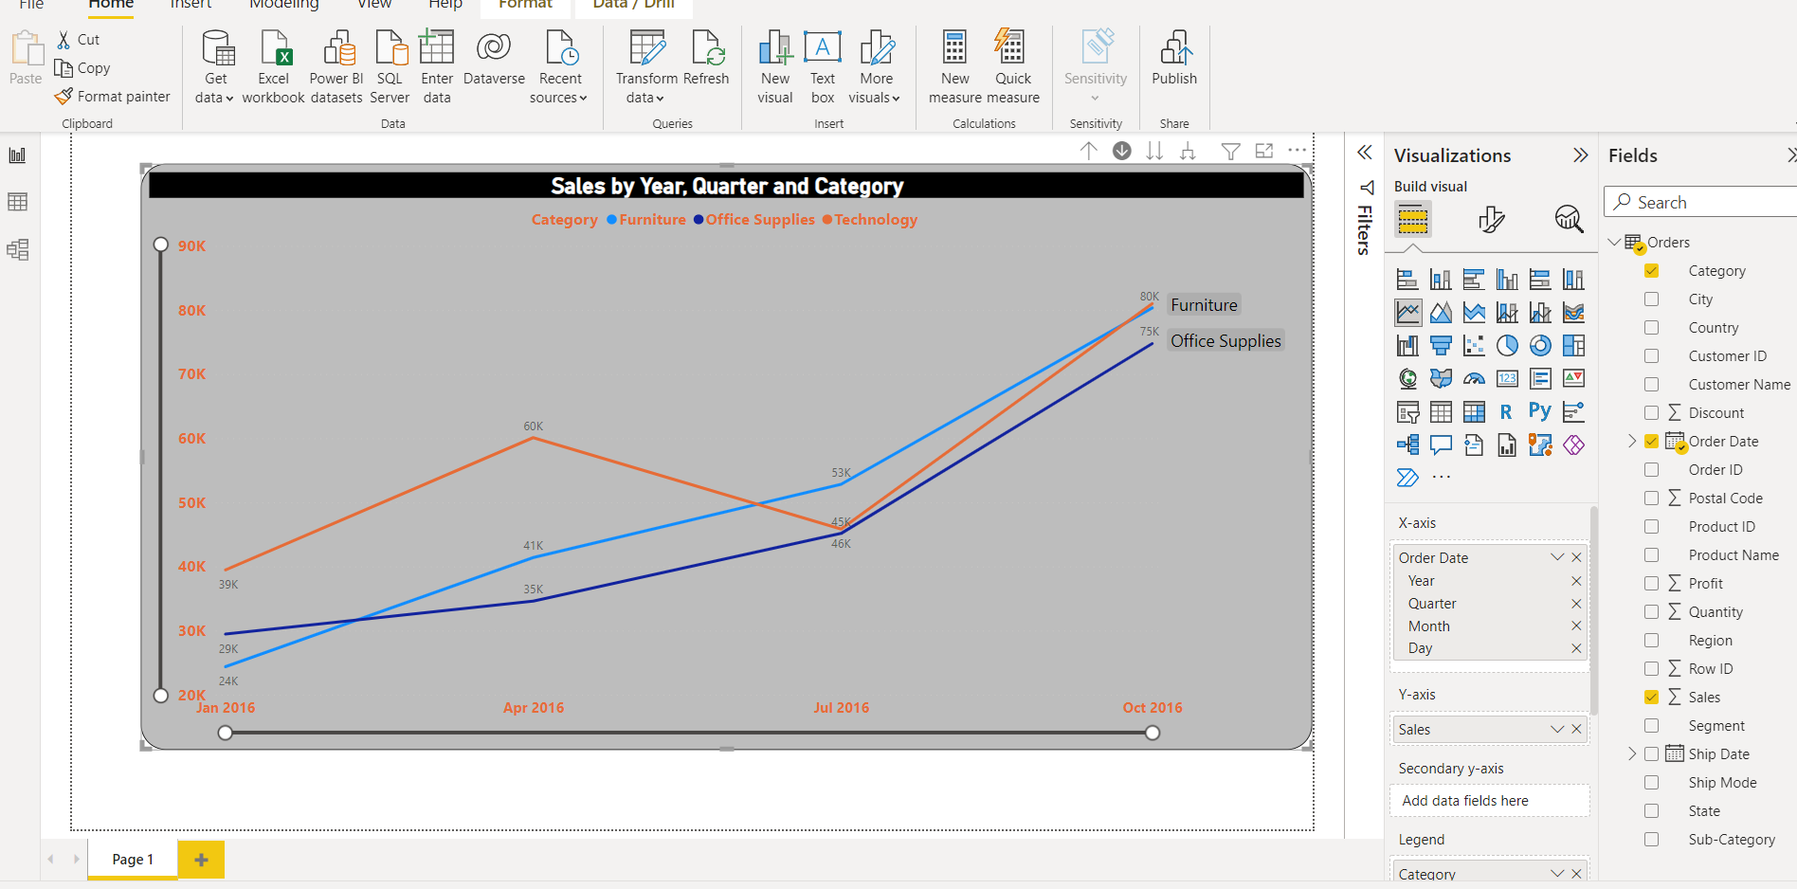
Line chart
To create a line chart we need to have a date field
It is generally used to display a trend
As the date field has been used in Line Chart it also gives the feature of Auto Hierarchy

Slide 33
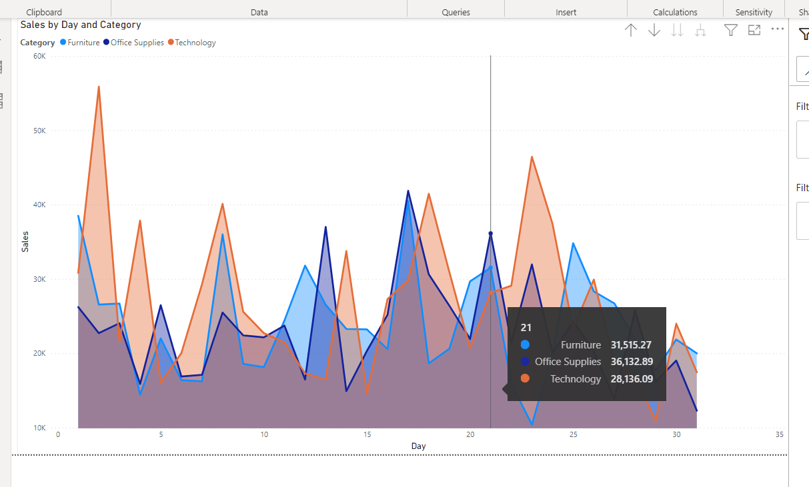
Area Chart in Power BI
Area Chart is the enhancement of line chart where the area below the line is filed.

Slide 34
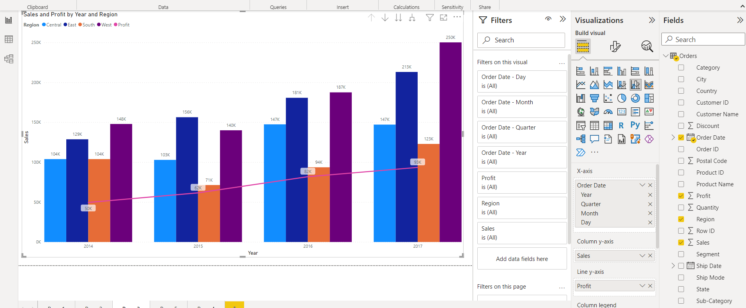
Combo Chart in Power BI
Combo Chart is a combination of Line & Column chart. Also be considers as dual axis chart. It is used to compare the two measures . Line & Clustered Column.

Slide 35
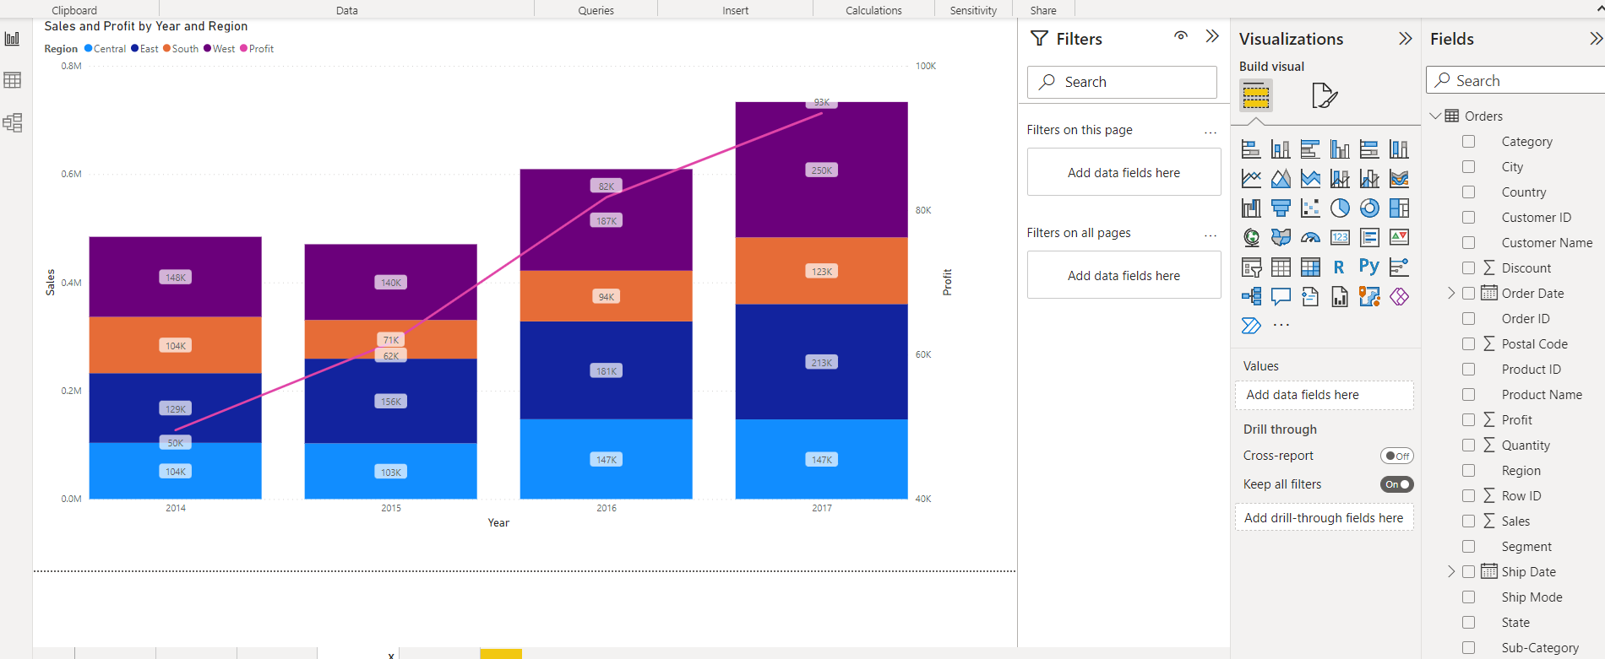
Combo Chart in Power BI
Combo Chart is a combination of Line & Column chart. Also be considers as dual axis chart. It is used to compare the two measures . Line & Stacked column

Slide 36
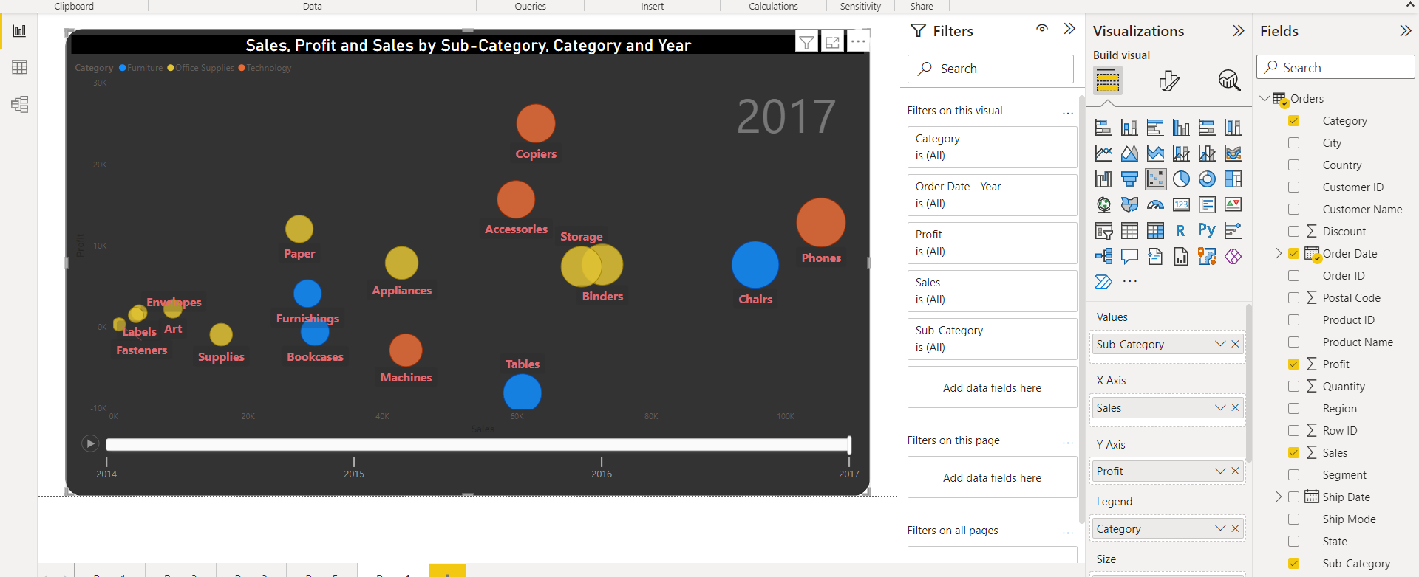
Scatter Chart in Power BI
Scatter chart is used to compare the two numeric files (measures) . It is the only default animation chart in Power BI.

Slide 37
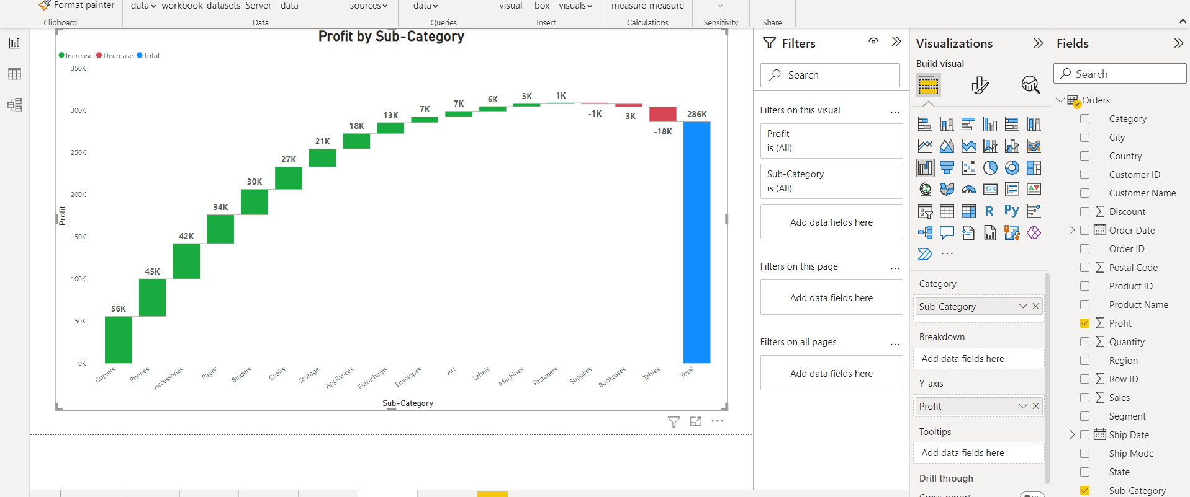
Waterfall Chart in Power BI
Waterfall chart is useful when we want to display the trend.

Slide 38
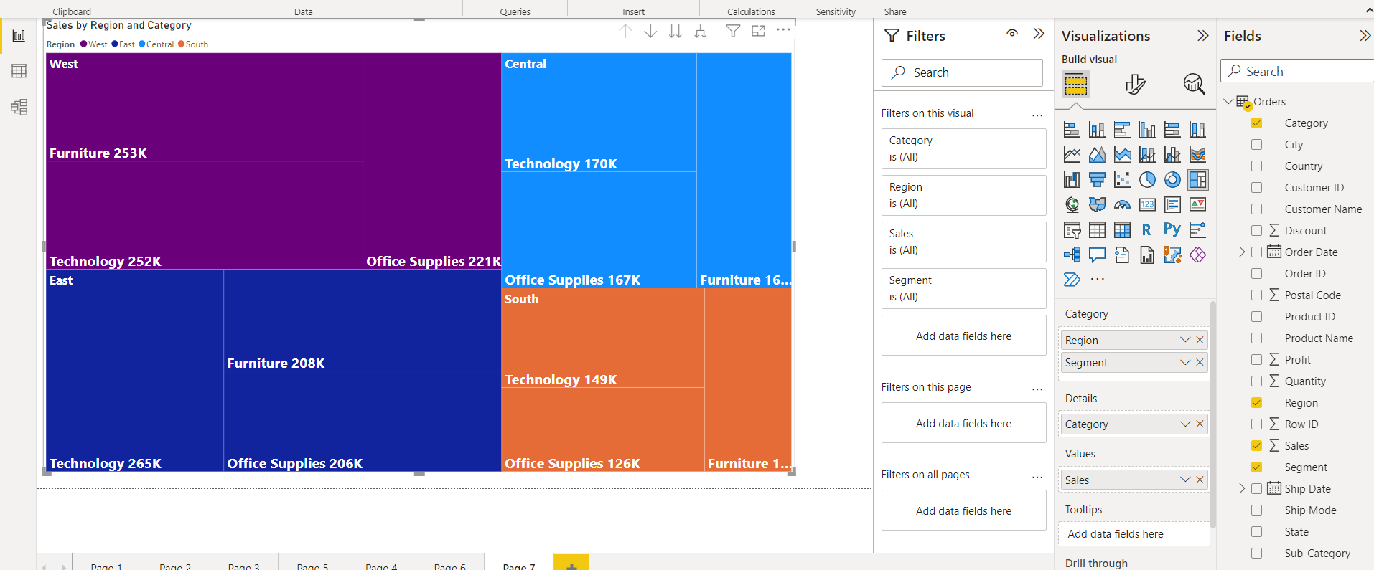
Tree Map in Power BI
Tree map displays the data in a form of boxes / rectangles of various size. These are useful to display a parent child relationship in the fields.

Slide 39
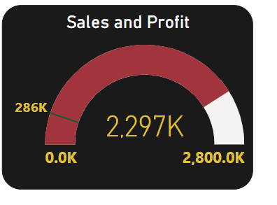
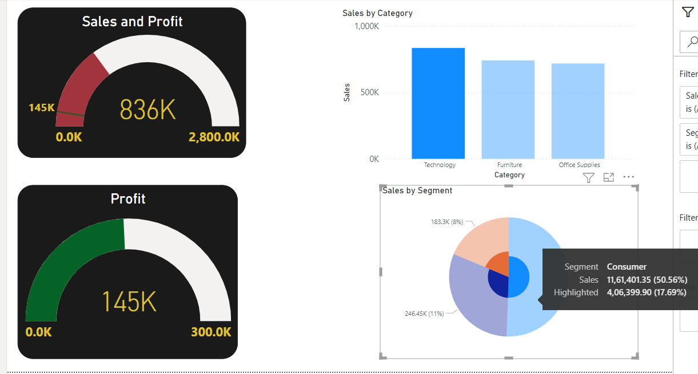
Gauge Chart in Power BI
gauge chart is a half circle and shows a single value that measures progress toward a goal . The line (or needle) represents the goal or target value and the filled circle represents the actual value.

Slide 40
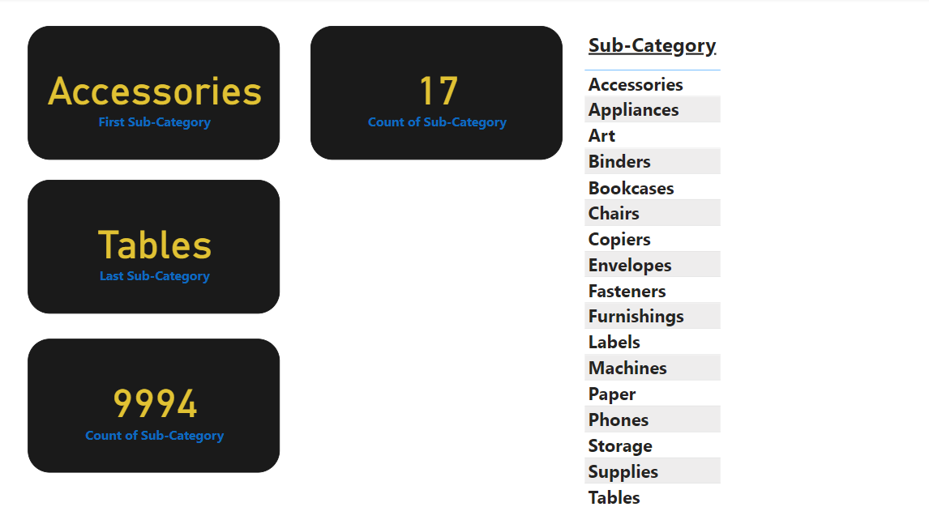
Cards in Power BI
Cards are the indicator which gives some value could be Number, Text Date .
Ex1 : Card with Text

Slide 41
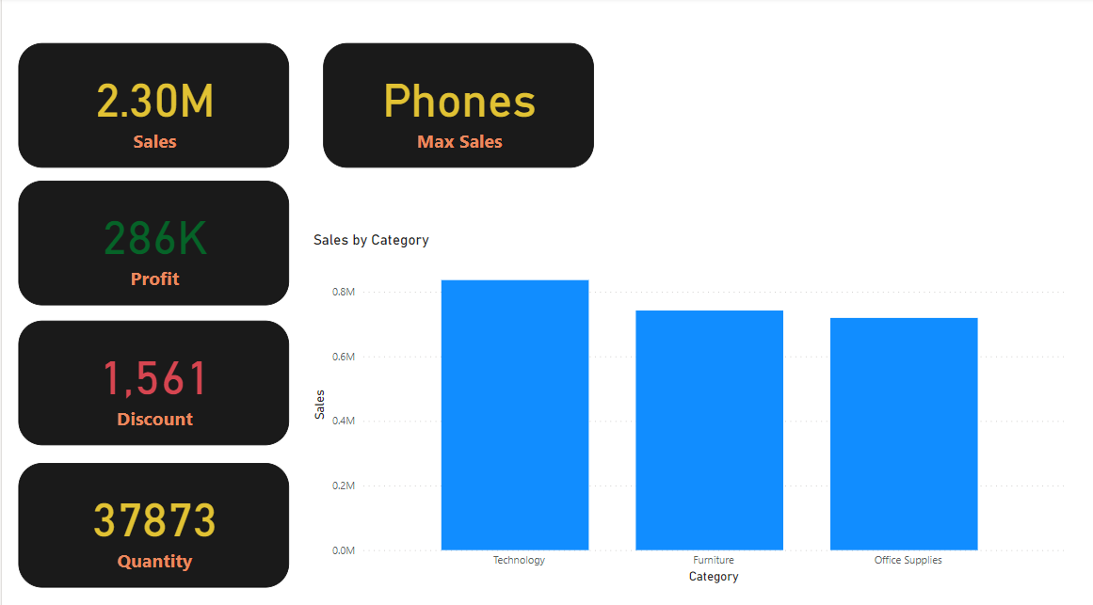
Ex2 : Card with Numbers

Slide 42
Ex3 : Card with Dynamic Text

Slide 43
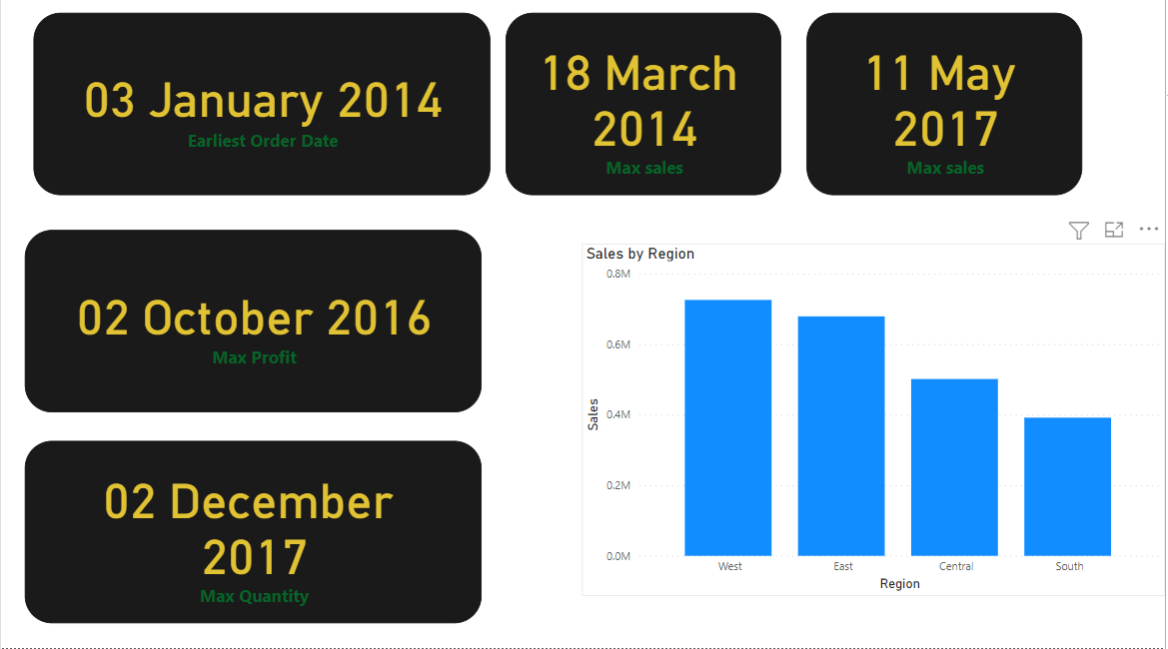
Ex4 : Card with Dates

Slide 44
Ex5 : Card with Relative Dates

Slide 45
Filters in Power BI :
Filters on this Visual
Filters on this page
Filters on all page

Slide 46
Drill through in Power BI
Drill through is used to navigate to different pages to drill down the information

Slide 47
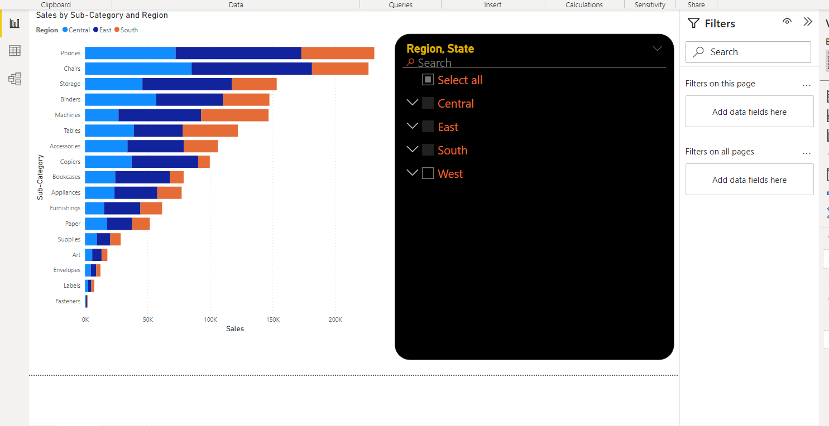
Slicers in Power BI
Text slicers:

Slide 48
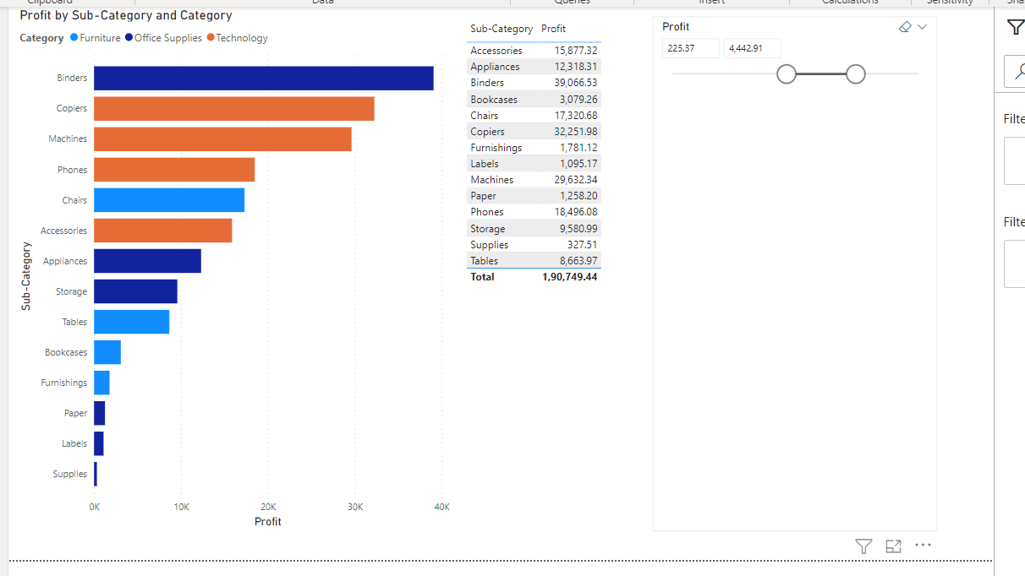
Slicers are the interactive filters - Numeric Slicers

Slide 49
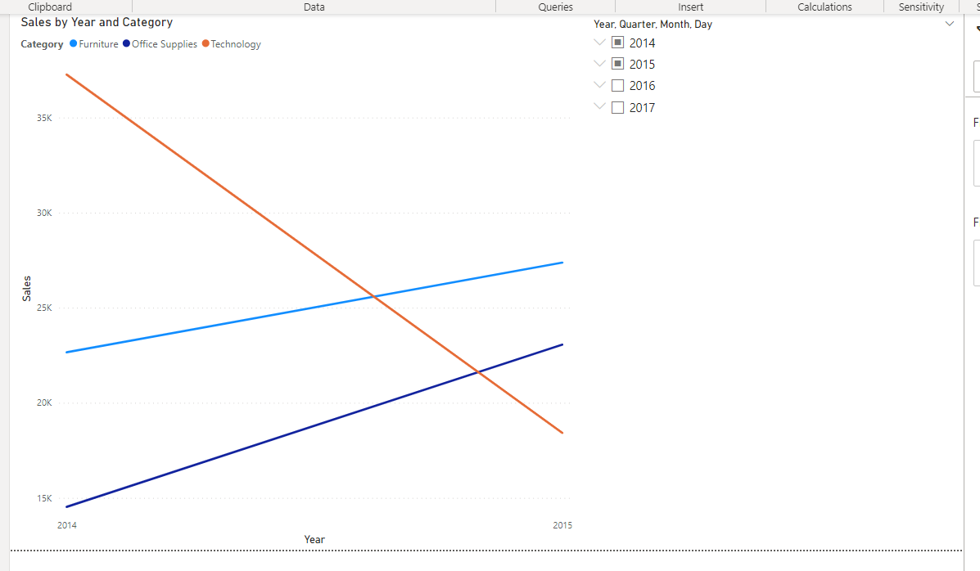
Slicers are the interactive filters - Date Slicers

Slide 50
Advanced chart-
In Power Bi you can import advance charts as add-ons developed by third party. To add the charts you need to have Power Bi account which can be created using corporate / university email ID.
Once logged in to Power Bi you will be taken to App Store from where you can add the charts to your desktop.
For Ex: Animated Bar chat, Word Cloud, InfoGraphic, Scroller, Sunburst

Slide 51
Inserting Objects in Power BI
Picture
Shape
Text Box
Button
Navigation
Action URL
Bookmark
Drill Through

Slide 52
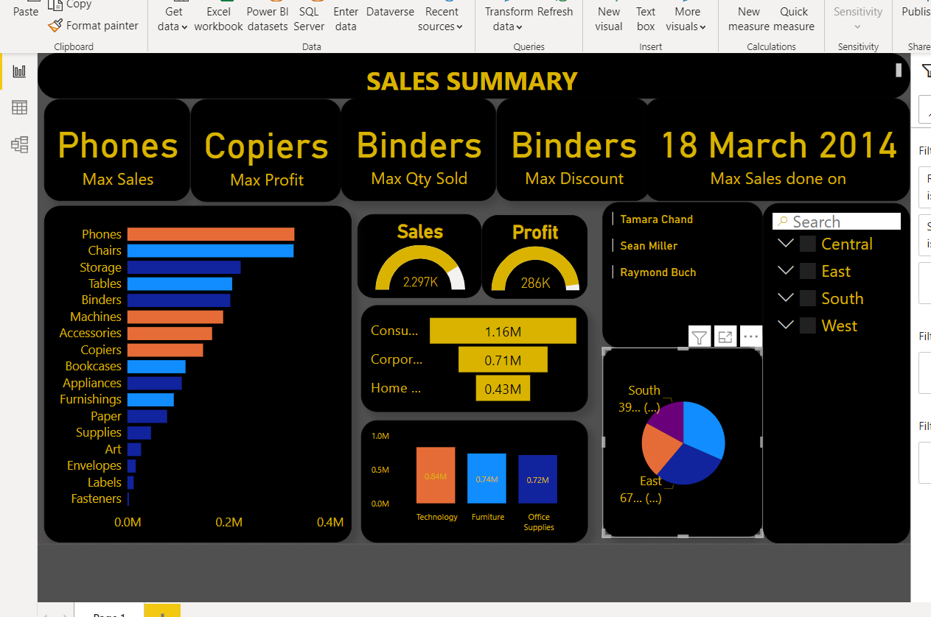
Report- A Report is a combination of multiple Visuals

Slide 53
Publishing On Power BI Service
Power BI Service is a sharing tool to share the visualization with other users. You need to create a Power BI Service account and publish your creation on it Home - > Publish

Slide 54
Comments, Subscribe, Share

Slide 55
Dashboard in Power BI
In Power Bi dashboard can be created only in Power BI Service. To ad a visual you just need to pin the Visual to the dashboard.
Power Bi dashboards are not interactive by default.
To make the dashboard interactive you need to pin the live page.
In the real time scenario Reports are majorly used.
These are actually useful if you want to see the static view

Slide 56

ASSIGNMENT
Visualize the data in any meaningful way to help the store to analyse the data. Design a report for the planning data based on country, sales, category, year, quarter
KPI :
Sales per Region
Sales per month
The max sales, max discount, max profit is given by which country.
The number of customers that we do have.
And so on, you can add as much information on your report as you want to analyze the data, please do remember that the visuas should be relevant. NOTE: The data set file will be uploaded and the link will be there in the description box

Slide 57
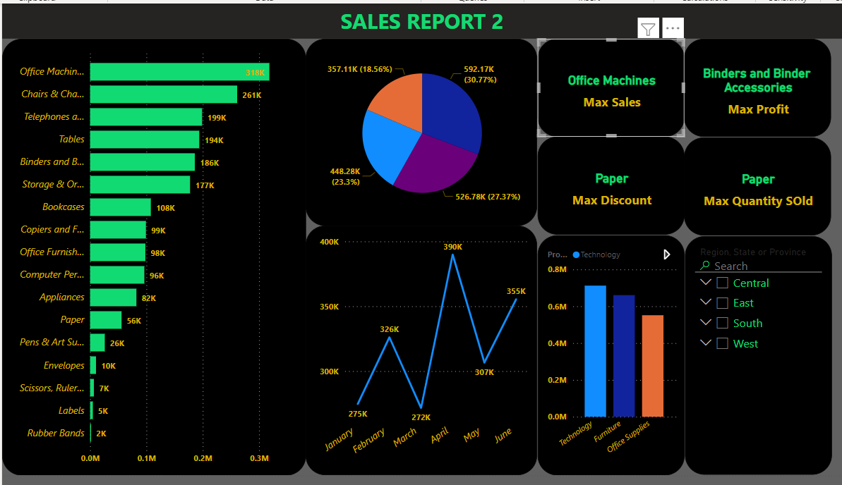

Slide 58
POWER QUERY
An Extract Transform Load tool

Slide 59
What is Power Query?
Power BI Desktop comes equipped with Power Query . You can use the Power Query to connect to one or many data sources, shape and transform the data. You could modify the data in hand to meet your needs, make it more usable, and then load that model into Power BI Desktop.
To get the Power Query editor select the data source and click on Transform
The best part of Power Query is you do not have to write any formula.
Without writing any formulae, we have many functions that can be used E.g :Text Functions / Date Functions/ Number Functions, Merge Split Change Case Extract (left, right, substring, Delimiter)

Slide 60
ASSIGNMENT
Make a new column by merging first and last name, and make is as Full Name.
Display the Tenure of each Employee
Display the Month and Day of Joining for each employee.
Create a employee code containing 1st character of 1st name, 1st character of last name and last 4 digits of EID
Increase each balance by 10k and rename it as Revise_salary
Calculate the 15% of balance as HRA.
Calculate the 5% of balance as PF.
Add balance, HRA, PF and display as Gross Salary
Sub PF from Gross Salary and display it as Net Salary.
Make few visualization as well:
1. The count of male and female employees.
2. Region wise no of employees, Category wise no of employees.
3. Tenurity of employee.
4. The no of joinee each month.

Slide 61
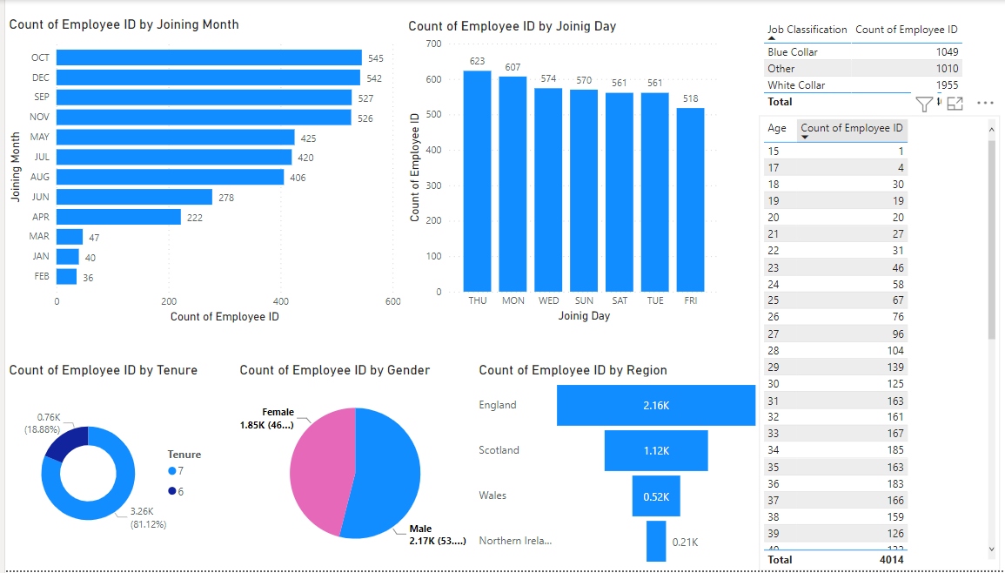

Slide 62
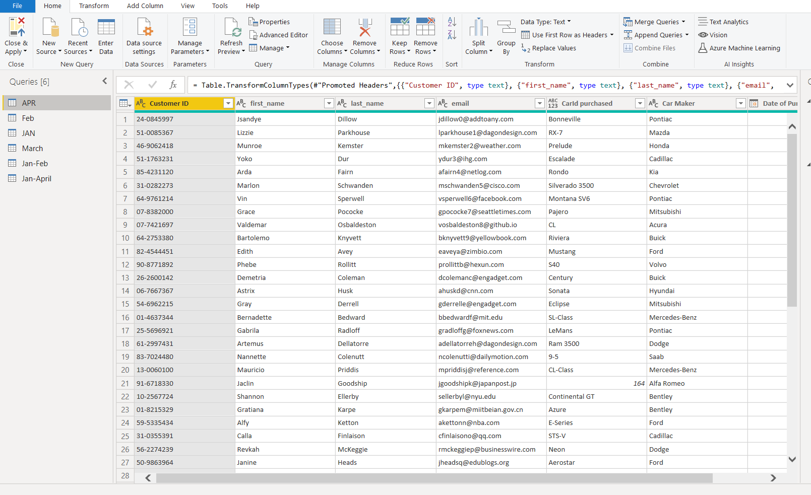
Appending Sheets in Power Query
Multiple sheets in Excel can be appended as a single sheets in Power BI. Go To Append Queries -> Append Query as New -> Select The sheets to be appended -> Click Add -> OK.

Slide 63
Merging Sheets in Power
Query Merging Sheets in Power Query can be considered as advanced lookup. Go To Merge Queries -> Select The tables to be merged -> Select the common field -> Specify the join type - > Ok

Slide 64
Columns From Example in Power Query
CFE is Just like Fast Fill In Excel. Many of the Text & date functions can be utilized without writing any function, Just by few clicks. (Split, Merge, Date Parts, Part of AlphaNumeric Data

Slide 65
Conditional Columns in Power Query
Conditional Column is just like IF Else formula in Excel without writing any code. To add a Conditional Column : Add Column -> Conditional Column -> Specify the condition

Slide 66
ASSIGNMENT
Let says we have a company ABC, we have data for the employees of that company. Visualize the data in any meaningful way to help the company to analyze the data. Design a report and include these things:
1.Create a visual to display no of employees on the basis of seniority level (tenure Years: > 8 highly tenured, 7-5 long tenured, 5-3 Mid tenured,3-1 short tenured, <1 intern
2.Grade the employees on the basis of salary (A >200000 / B >100000/ C >80000 /D <= 50000) and create a visual to get the percentage of employees on the basis of grade.
3.Check if the current and joined designation is same or not, if they are not same that means that person has been promoted, create a visualization to display the promotion percentage
4.Display City wise bifurcation of Grades.

Slide 67
Auto Fill in Power Query
Auto Fill in Power Query

Slide 68
Grouping in Power Query

Slide 69
Transpose Data in Power Query

Slide 70
Unpivot Data in Power Query

Slide 71
Data type in Power Query

Slide 72
Keep Remove Rows in Power Query

Slide 73
Manipulating Columns in Power Query

Slide 74
Data Modelling in Power BI
Data Modeling is used to connect multiple data sources using relationship and allows us to create visuals based on multiple data sources.

